Slide 1


Slide 2
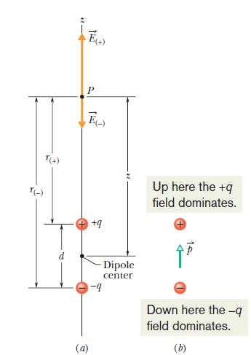
Electric dipole
Two charged particles of magnitude q but of opposite sign, separated by a distance d, this configuration is called an electric dipole

Slide 3
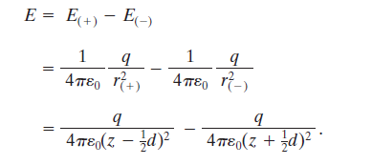
The Electric Field Due to an Electric dipole
By superposition principle for electric fields, we find the magnitude E at P is

Slide 4


The Electric Field Due to an Electric dipole

Slide 5
The Electric Field Due to an Electric dipole
We are usually interested in the electrical effect of a dipole only at distances that are large compared with the dimensions of the dipole—that is, at distances such that z>>d. At such large distances, we have d/2z<<1 . Thus, in our approximation, we can neglect the d/2z term in the denominator, which leaves us with

Slide 6


The Electric Field Due to an Electric dipole

Slide 7

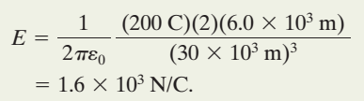

Problem
If q=200 C and h=6.0 km, what is the magnitude of the dipole’s electric field at altitude z₁=30 km somewhat above the clouds and altitude z₂=60 km somewhat above the stratosphere?

Slide 8
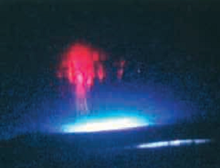
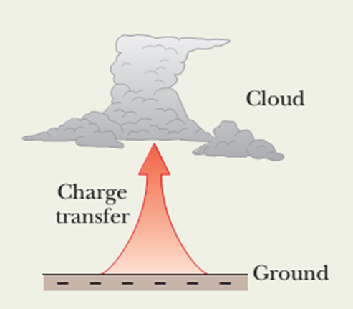
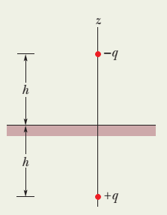

Slide 9
The Electric Field Due to a Line of Charge
We now consider charge distributions that consist of a great many closely spaced point charges (perhaps billions) that are spread along a line, over a surface, or within a volume.
Such distributions are said to be continuous rather than discrete.

Slide 10
The Electric Field Due to a Line of Charge
We now consider charge distributions that consist of a great many closely spaced point charges (perhaps billions) that are spread along a line, over a surface, or within a volume.
Such distributions are said to be continuous rather than discrete.

Slide 11
The Electric Field Due to a Line of Charge
Since these distributions can include an enormous number of point charges,
we find the electric fields that they produce by means of calculus rather than by considering the point charges one by one

Slide 12
The Electric Field Due to a Line of Charge
When dealing with continuous charge distributions, it is most convenient to express the charge on an object as a charge density rather than as a total charge.
charge density: charge per unit length
SI unit is the coulomb per meter

Slide 13
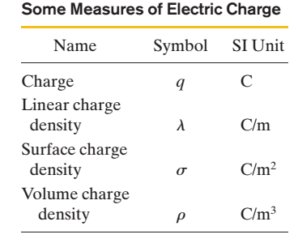
Some measure of Electric Charge

Slide 14
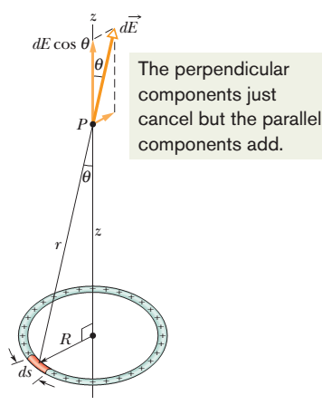
The Electric Field Due to a Line of Charge
A thin ring of radius R with a uniform positive linear charge density l around its circumference.
What is the electric field at point P, a distance z from the plane of the ring along its central axis?

Slide 15



For Z=0. At that point, E=0. This is a reasonable result because if we were to place a test charge at the center of the ring, there would be no net electrostatic force acting on it; the force due to any element of the ring would be canceled by the force due to the element on the opposite side of the ring. If the force at the center of the ring were zero, the electric field there would also have to be zero.

Slide 16
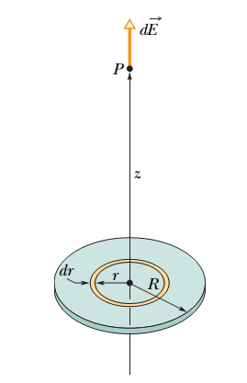



The E Field Due to a Charged Disk
If we let R→∞ while keeping z finite, the second term in the parentheses in above eq. approaches zero, and this equation reduces to

